Slide 1
Relational DBMS

Slide 2
Relational Database
A relational database is a set of tables (datasets with rows and columns) that contain information relating to other tables in the database.
Example:
The diagram below contains information about columns in two tables in an example relational database. Both tables contain columns named customer_id, which establishes a relationship between the tables. As the company grows and records thousands (or millions) of orders, storing data in separate tables helps optimize for space and reduce the size of the database.
Custumors
custumor_id name company phone email date_joined
Orders
custumor_id order_id date count_items Total_amount

Slide 3
SQL(Structured Query Language)
To interact with relational databases, we tend mostly to use SQL.
With SQL, we can query, or ask questions of, the data in a relational database.
Working with SQL and relational databases is an invaluable skill set for a data analyst, data engineer, or a data scientist.
Most popular DBMS databases:
PostgreSQL
MySQL
SQL Server

Slide 4
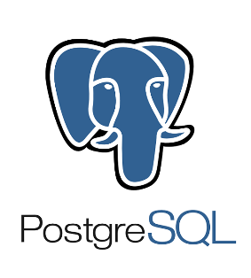
PostgreSQL
PostgreSQL is the less popular DBMS among the three mentioned before. However, it is highly recommended for beginners because its syntax most closely conforms to Standard SQL. This means that you can easily translate your skills to other database management systems such as MySQL or SQLite.
The origins of PostgreSQL date back to 1986 as part of the POSTGRES project at the University of California at Berkeley and has more than 30 years of active development on the core platform.
PostgreSQL comes with many features aimed to help developers build applications, administrators to protect data integrity and build fault-tolerant environments, and help you manage your data no matter how big or small the dataset. In addition to being free and open source, PostgreSQL is highly extensible. For example, you can define your own data types, build out custom functions, even write code from different programming languages without recompiling your database.

Slide 5
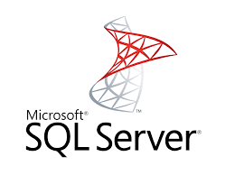
SQL Server
Microsoft SQL Server is a RDMS developed by Microsoft. As a database server it is a software product with the primary function of storing and retrieving data as requested by other software applications.
Data can be stored in a database which is a collection of tables with typed columns,
SQL Server allows multiple clients to use the same database concurrently. As such, it needs to control concurrent access to shared data, to ensure data integrity—when multiple clients update the same data, or clients attempt to read data that is in the process of being changed by another client.
The main mode of retrieving data from a SQL Server database is querying for it. The query is expressed using a variant of SQL called T-SQL, a dialect Microsoft SQL Server shares with Sybase SQL Server due to its legacy.

Slide 6
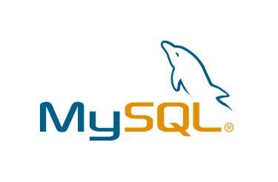
MySQL
MySQL is the most popular open source relational Database Management System.
MySQL was created by a Swedish company, MySQL AB, founded by David Axmark, Allan Larsson and Michael Widenius. Original development of MySQL by Widenius and Axmark began in 1994. The first version of MySQL appeared on 23 May 1995.
The MySQL Database Server is very fast, reliable, scalable, and easy to use.
The MySQL Database Software is a client/server system that consists of a multithreaded SQL server that supports different back ends, several different client programs and libraries, administrative tools, and a wide range of application programming interfaces (APIs).
Fun Fact: The official way to pronounce “MySQL” is “My Ess Que Ell” (not “my sequel”), but we do not mind if you pronounce it as “my sequel” or in some other localized way.

Slide 7
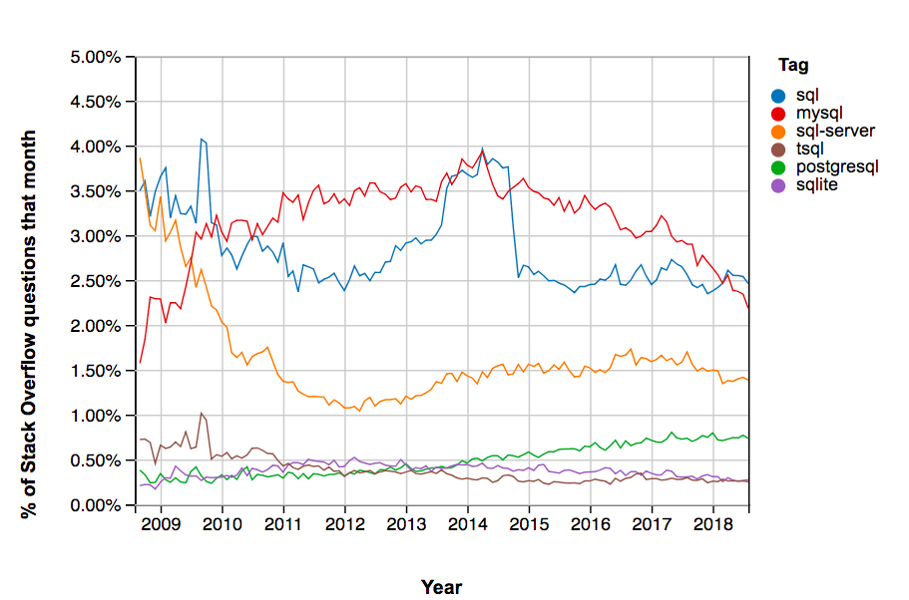
Comapraison
MySQL has consistently been the most popular version of SQL in Stack Overflow questions. Second in line is Microsoft SQL Server (including T-SQL, the name of Microsoft’s dialect of SQL), which remains a consistently more popular tag than PostgreSQL. The graph below illustrates that:

Slide 8
The Difference Between the DBMS
Name | SQL Server | MySQL | PostgreSQL
Description | Microsoft’s relational DBMS | Widely used open source RDBMS | Widely used open source RDBMS
Developer | Microsoft | Oracle | PostgreSQL Global Development Group
Data scheme | Yes | Yes | Yes
Server-side scripts | Transact SQL, .NET languages, R, Python and Java | Yes | user defined functions
In-memory capabilities | Yes | Yes | No
SELECT ... | Select [col1], [col2] | SELECT col1, col2 | SELECT col1, col2
Using quotation marks | name = ‘John’ only | name = ‘John’ or name = “John” | name = ‘John’ only

